Slide 1


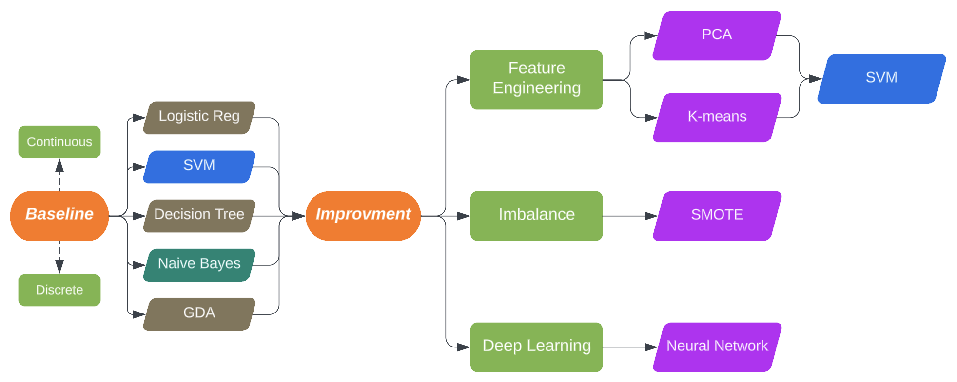
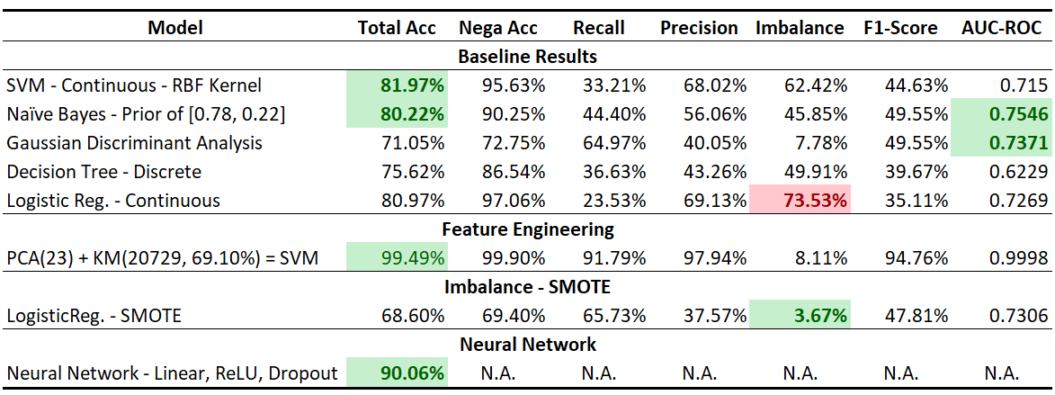
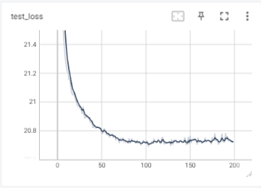
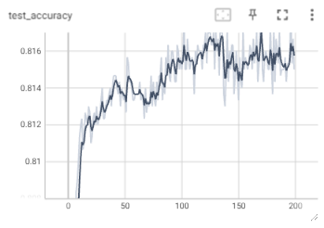
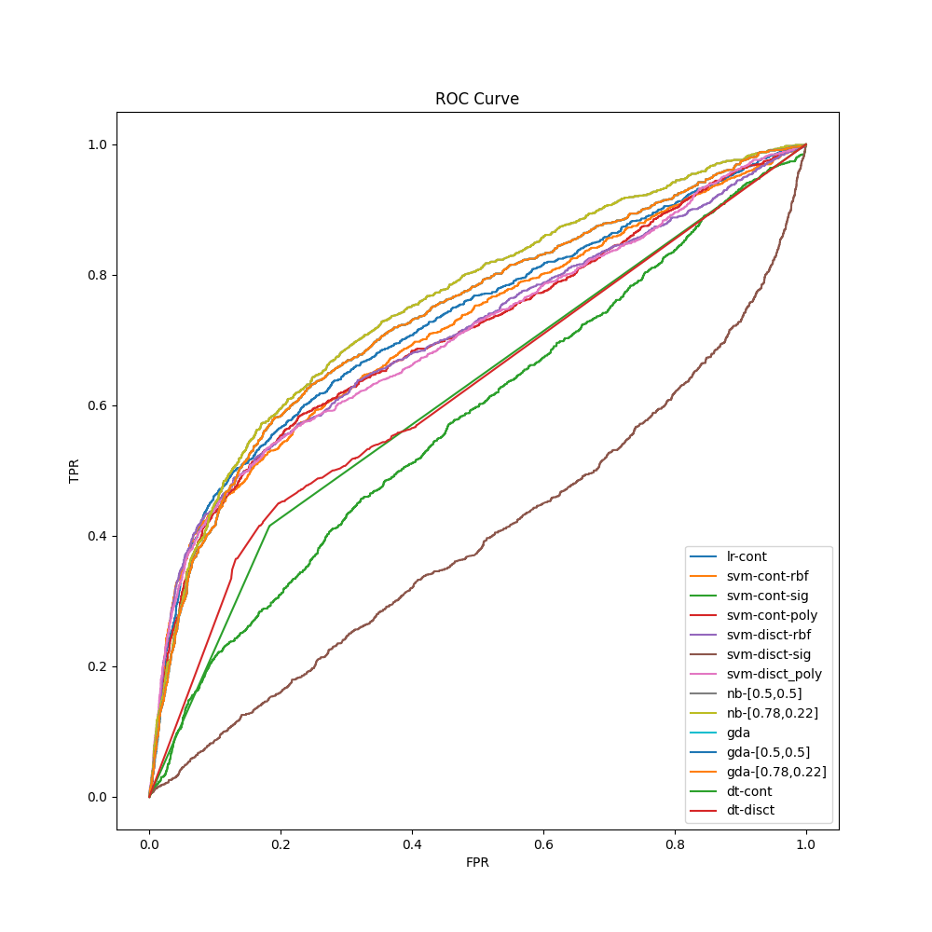
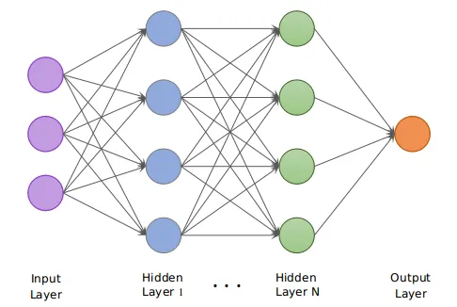
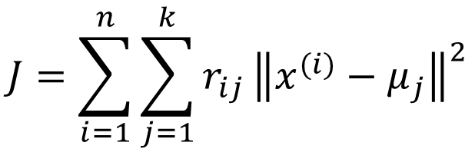
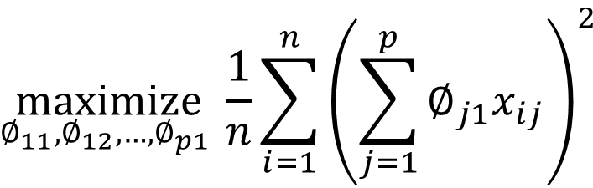
Credit Card Default Analysis – Machine Learning Algorithms
Xinxie Wu, xinxiewu@gmai.com
Predicting
Dataset & Features: Default of Credit Card Clients
2-Part Methodology: Models & Workflow
Credit Card Default
Dataset has 30k observations, 6,636 (22%) default; includes 23 attributes covering demographic and card historical information. All features are used and further analyzed by PCA & K-means.
EDA:
No Missing Value – Reasonable Values
Normalization & Discretization (9 Categories)
Correlation Matrix – Marriage & Age (0.41)
Training vs Testing: 80% / 20%
Principal Component Analysis (23)
K-means (2)
Baseline Models
$$\underset{∅_{11},∅_{12},…, ∅_{p1} }{maximize}{\frac{1}{n}\sum_{i=1}^{n}{{\left(\sum_{j=1}^{p}{∅_{j1}x_{ij}}\right)}^{2}}}$$
SVM re-training determines the optional # as 23
$$J=\sum_{i=1}^{n}{\sum_{j=1}^{k}{r_{ij}}{\left\|x^{(i)}−μ_{j}\right\|}^{2}}$$
For baseline algorithms:
Continuous: SVM, with rbf kernel, achieves 81.97% accuracy; GDA reaches the highest AUC-ROC as 0.74, with F1 score 0.50.
Discrete: Naïve Bayes, with (0.78, 0.22) prior distribution, gains 80% accuracy; also, this NB reaches AUC-ROC as 0.76.
Logistic Regression shows the highest imbalance gap (73.5%)
Neural Network
Results & Discussion
Results & Discussion:
Baseline models show total accuracy ~80%, but >45% negative-positive gap;
SMOTE removes the negative-positive gap, but brings overfitting (68.60%);
PCA returns an optimal number as 23, K-means removes 9,271 obs. Improved SVM accuracy 99.49%;
4-layers network performs best with 89.61%; 90.91% if convolutional layers are added.
Dataset is split into training (80%), validation (10%) and testing (10%).
Convolutional layer is NOT in this research.
Future Work
References
For the future work, k-fold cross-validation is under consideration since our research focused on 8/2 dataset split. Also, neural networks with more different number of layers/neurons need to be trained and compare the performance. Finally, SMOTE shows overfitting and so poor generalization ability; methods besides sampling, such as kernel-based and cost-sensitive, should be considered and tested.
[1] Liu, R.L. (2018) Machine Learning Approaches to Predict Default of Credit Card Clients. Modern Economy, 9, 1828-1838.
[2] I-Cheng Yeh, Che-hui Lien. The comparisons of data mining techniques for the predictive accuracy of probability of default of credit card clients. Expert Systems with Applications, Volume 36, Issue 2, Part 1, 2009, Pages 2473-2480, ISSN 0957-4174.
[3] Husejinovic, Admel and Kečo, Dino and Masetic, Zerina, Application of Machine Learning Algorithms in Credit Card Default Payment Prediction (October 1, 2018). A Husejinovic, D Keco, Z Masetic, International Journal of Scientific Research 7 (10), 425-426, 2018.

